Slide 1
Sozo Inventory Web App
The Daily Grind
Isidore, Caroline, Tim
April 13, 2021

Slide 2
Project Summary
To build a simple, easy-to-use inventory application that helps the Sozo Coffeehouse manage its inventory. The backend is written in Python via the Django Framework, while the frontend is rendered using Bootstrap. Data are stored in a MySQL database. The application will be made available via an Amazon EC2 instance.

Slide 3
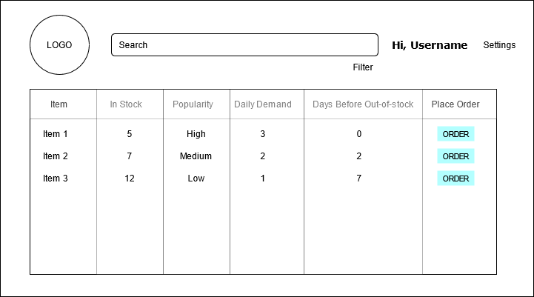
Main Page
Add new Users
Set automation parameters
Unique view for all users
Only managers can place orders

Slide 4
Key Features
This web application will let users:
Search for specific items in inventory
Add new items to inventory
Delete no longer offered items
Automate ordering items based on quantity thresholds
Manually add selected items to list
Regulate employee/manager access based on permissions and roles

Slide 5
Technologies Used
Web framework - Django (Python)
django-crispy-forms
django-mssql-backend
bootstrap4
Database - SQL Server
Amazon EC2 Instance

Slide 6
Demo
Webtool
Main Page
Using Github Project Board for project schedule/task planning
Kanban Board
Github for version control
DailyGrind Repository

